Slide 1
Module 2:Process Management
[ 09 Hrs] [ Blooms ‘level selected: L2]
Process Concept, Operations on Processes, Inter Process Communication, Introduction to threads - Multithreading Models, Process Scheduling– Basic concepts, Scheduling Criteria, Scheduling Algorithms: FCFS, SJF, RR, Priority, Multilevel Queue, Multilevel Feedback Queue.
Linux Operating System: Process Management Commands and System Calls.

Slide 2
PROCESS CONCEPT
An operating system executes a variety of programs:
      Batch system – jobs
      Time-shared systems – user programs or tasks
Process – a program in execution; process execution must progress in sequential fashion
Multiple parts
      The program code, also called text section
      Current activity including program counter, processor registers
      Stack containing temporary data
        Function parameters, return addresses, local variables
      Data section containing global variables
      Heap containing memory dynamically allocated during run time

Slide 3
PROCESS CONCEPT (CONT.)
Program is passive entity stored on disk (executable file), process is active
      Program becomes process when executable file loaded into memory
Execution of program started via GUI mouse clicks, command line entry of its name, etc
One program can be several processes
      Consider multiple users executing the same program

Slide 4
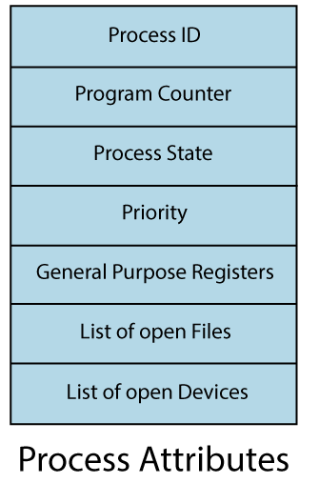
Attributes /Characteristics of a Process:
    Process Id
    2) Process State
    3) CPU registers
    4) I/O status information
    5) CPU scheduling information

Slide 5

PROCESS IN MEMORY

Slide 6
PROCESS STATE
As a process executes, its state changes. The various states of a process are:
  New: A Newly Created Process
  Ready: When the process is ready for execution
  Running: Currently running process in the CPU (only one process at a time can be in execution in a single processor).
  Waiting(or Block): When a process requests for I/O operation, etc.
  Complete(or Terminated): The process completed its execution successfully.
  Suspended Ready: When the ready queue(buffer) becomes full, some processes are moved to suspended ready state
  Suspended Block: When waiting queue(buffer) becomes full.

Slide 7

DIAGRAM OF PROCESS STATE

Slide 8
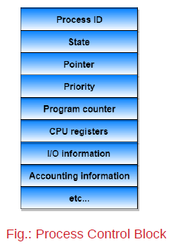
PROCESS CONTROL BLOCK (PCB)
Every process has its own process control block(PCB), i.e.; each process will have a unique PCB (also called task control block). A PCB has the following information about a process:
Process state - running, waiting, etc
Program counter - location of instruction to next execute
CPU registers - contents of all process-centric registers
CPU scheduling information- priorities, scheduling queue pointers
Memory-management information - memory allocated to the process
Accounting information - CPU used, clock time elapsed since start, time limits
I/O status information – I/O devices allocated to process, list of open files

Slide 9

CPU SWITCH FROM PROCESS TO PROCESS
WHAT HAPPENS WHEN THE CPU SWITCHES FROM A PROCESS TO ANOTHER PROCESS?

Slide 10
SCHEDULERS
Short-term scheduler (or CPU scheduler) – selects which process should be executed next and allocates CPU
  Sometimes the only scheduler in a system
  Short-term scheduler is invoked frequently (milliseconds) ⇒ (must be fast)
Long-term scheduler (or job scheduler) – selects which processes should be brought into the ready queue
  Long-term scheduler is invoked infrequently (seconds, minutes) ⇒ (may be slow)
  The long-term scheduler controls the degree of multiprogramming
Processes can be described as either:
  I/O-bound process – spends more time doing I/O than computations, many short CPU bursts
  CPU-bound process – spends more time doing computations; few very long CPU bursts
Long-term scheduler strives for good process mix

Slide 11
CONTEXT SWITCH
When CPU switches to another process, the system must save the state of the old process and load the saved state for the new process via a context switch
Context of a process represented in the PCB
Context-switch time is overhead; the system does no useful work while switching
    The more complex the OS and the PCB ➔ the longer the context switch
Time dependent on hardware support
    Some hardware provides multiple sets of registers per CPU ➔ multiple contexts loaded at once
When does a context switch happen?
When a high-priority process comes to ready state
2. An Interrupt occurs
3. User and kernel mode switch (It is not necessary though)
4. Pre-emptive CPU scheduling used.
Context switching allows multiple processes to share a single central processing unit(CPU)

Slide 12
OPERATIONS ON PROCESSES
System must provide mechanisms for:
    process creation,
    process termination, and so on

Slide 13
THREADS
So far, process has a single thread of execution
Consider having multiple program counters per process
    Multiple locations can execute at once
      Multiple threads of control -> threads
Must then have storage for thread details, multiple program counters in PCB
See next chapter

Slide 14
PROCESS CREATION
Parent process create children processes, which, in turn create other processes, forming a tree of processes
Generally, process identified and managed via a process identifier (pid)
Resource sharing options
      Parent and children share all resources
      Children share subset of parent’s resources
      Parent and child share no resources
Execution options
      Parent and children execute concurrently
      Parent waits until children terminate

Slide 15

A TREE OF PROCESSES IN LINUX
Fig.: A Tree of Processes in Linux

Slide 16

PROCESS CREATION (CONT.)
Address space
    Child duplicates parent
    Child has a program loaded into it
UNIX examples
    fork() system call creates new process
    exec() system call used after a fork() to replace the process’ memory space with a new program

Slide 17
C PROGRAM FORKING SEPARATE PROCESS
#include <sys/types.h>
#include <stdio.h>
#include <unistd.h>
int main()
{
  pid t pid;
  /* fork a child process */
  pid = fork();
  if (pid < 0) { /* error occurred */
      fprintf(stderr, "Fork Failed");
      return -1;
  }
  else if (pid == 0) { /* child process */
  execlp("/bin/ls","ls",NULL);
  }
  else { /* parent process */
  /* parent will wait for the child to complete */
  wait(NULL);
  printf("Child Complete");
  }
  return 0;
}

Slide 18
PROCESS TERMINATION
Process executes last statement and then asks the operating system to delete it using the exit() system call.
      Returns status data from child to parent (via wait())
      Process’ resources are deallocated by operating system
Parent may terminate the execution of children processes using the abort() system call.
Some reasons for doing so:
      Child has exceeded allocated resources
      Task assigned to child is no longer required
      parent is exiting and the operating systems does not allow a child to continue if its parent terminates

Slide 19
PROCESS TERMINATION
Some operating systems do not allow child to exists if its parent has terminated. If a process terminates, then all its children must also be terminated.
    cascading termination. All children, grandchildren, etc. are terminated.
    The termination is initiated by the operating system.
Parent process may wait for termination of a child process by using the wait()system call.
  call returns status information and the pid of the terminated process
pid = wait(&status);
If no parent waiting (did not invoke wait()) process is a zombie
If parent terminated without invoking wait , process is an orphan

Slide 20
INTERPROCESS COMMUNICATION
Processes within a system may be
      independent or
        cooperating
Cooperating process can affect or be affected by other processes, including sharing data
Reasons for cooperating processes:
      Information sharing
      Computation speedup
      Modularity
      Convenience
Cooperating processes need interprocess communication (IPC)
Two models of IPC
    Shared memory- a region of memory is shared by cooperating processes- Faster
    Message passing - communication takes place by means of messages exchanged between the cooperating processes- useful for exchanging smaller amounts of data

Slide 21
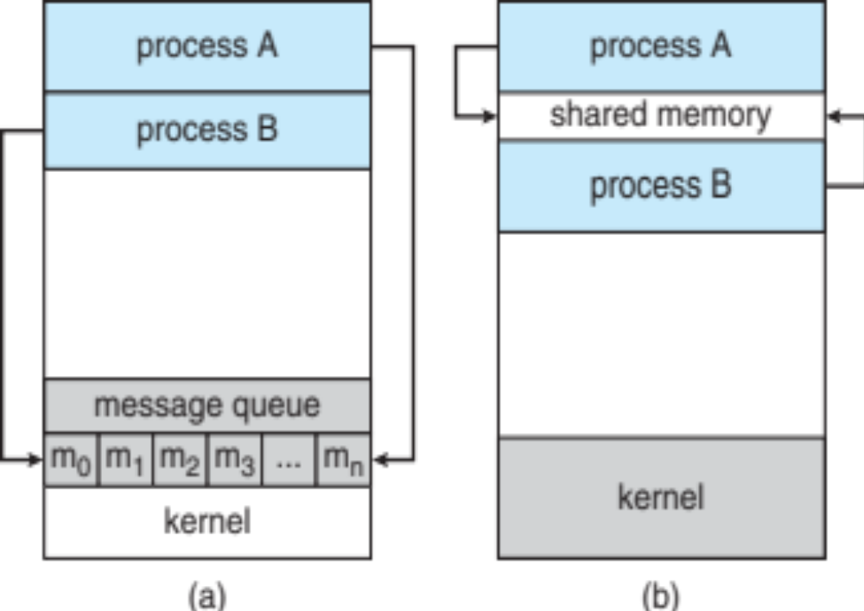
COMMUNICATIONS MODELS
(a) Message passing. (b) shared memory.

Slide 22
Message Passing:
  Communication by Establishing a communication link (if a link already exists, no need to establish it again.)
  Suitable for Distributed environments
  Start exchanging messages using basic primitives:
  send(message)
  receive(message)
Shared Memory:
  Area of memory shared among the processes that wish to communicate
  Communication is under the control of the users processes not the operating system.
  Major issues is to provide mechanism that will allow the user processes to synchronize their actions when they access shared memory
  Cache Cohency issue

Slide 23
COOPERATING PROCESSES
PRODUCER-CONSUMER PROBLEM
Paradigm for cooperating processes, producer process produces information that is consumed by a consumer process
For example,
  a compiler may produce assembly code that is consumed by an assembler.
  assembler, in turn, may produce object modules that are consumed by the loader
provides a metaphor for the client–server paradigm
solution to the producer–consumer problem uses shared memory- BUFFER
  unbounded-buffer places no practical limit on the size of the buffer
  bounded-buffer assumes that there is a fixed buffer size

Slide 24
SYNCHRONIZATION
Message passing may be either blocking or non-blocking
Blocking is considered synchronous
  Blocking send -- the sender is blocked until the message is received
  Blocking receive -- the receiver is blocked until a message is available
Non-blocking is considered asynchronous
  Non-blocking send -- the sender sends the message and continue
  Non-blocking receive -- the receiver receives:
    A valid message, or
    Null message
Different combinations possible
  If both send and receive are blocking, we have a rendezvous

